Slide 1

New Method For Maze Solving Algorithms
Ferdowsi University of Mashhad
Faculty of Mathematic
Adviser : ---
Researcher : Nima Fakoor

Slide 2
Maze
Maze Construction
Generating Mazes
Solving Mazes
Maze Generation Algorithm
Graph Theory Based Methods
Recursive Division Method
Cellular Automaton Algorithms
Maze Solving Algorithm
Random Mouse Algorithm
Wall Follower
Dead-end filling
Recursive algorithm

Slide 3
New Method For Maze Solving Algorithms
Theorem
Proof
Lemma (I)
Lemma (II)
Example
Applications
FAQ

Slide 4
Maze
A maze is a path or collection of paths, typically from an entrance to a goal. The word is used to refer both to branching tour puzzles through which the solver must find a route, and to simpler non-branching ("unicursal") patterns that lead unambiguously through a convoluted layout to a goal. (The term "labyrinth" is generally synonymous, but also can connote specifically a unicursal pattern.[1]) The pathways and walls in a maze are typically fixed, but puzzles in which the walls and paths can change during the game are also categorized as mazes or tour puzzles.

Slide 5
Maze Construction
Mazes have been built with walls and rooms, with hedges, turf, corn stalks, hay bales, books, paving stones of contrasting colors or designs, and brick,[2] or in fields of crops such as corn or, indeed, maize. Maize mazes can be very large; they are usually only kept for one growing season, so they can be different every year, and are promoted as seasonal tourist attractions. Indoors, mirror mazes are another form of maze, in which many of the apparent pathways are imaginary routes seen through multiple reflections in mirrors. Another type of maze consists of a set of rooms linked by doors (so a passageway is just another room in this definition). Players enter at one spot, and exit at another, or the idea may be to reach a certain spot in the maze. Mazes can also be printed or drawn on paper to be followed by a pencil or fingertip. Mazes can be built with snow.

Slide 6
Solving mazes
Maze solving is the act of finding a route through the maze from the start to finish. Some maze solving methods are designed to be used inside the maze by a traveler with no prior knowledge of the maze, whereas others are designed to be used by a person or computer program that can see the whole maze at once.
The mathematician Leonhard Euler was one of the first to analyze plane mazes mathematically, and in doing so made the first significant contributions to the branch of mathematics known as topology.
Mazes containing no loops are known as "standard", or "perfect" mazes, and are equivalent to a tree in graph theory. Thus many maze solving algorithms are closely related to graph theory. Intuitively, if one pulled and stretched out the paths in the maze in the proper way, the result could be made to resemble a tree.[3]
Maze Solving is Non-Deterministic Polynomial Complete (NP-Complete) problem

Slide 7
Generating mazes
Maze generation is the act of designing the layout of passages and walls within a maze. There are many different approaches to generating mazes, with various maze generation algorithms for building them, either by hand or automatically by computer.
There are two main mechanisms used to generate mazes. In "carving passages", one marks out the network of available routes. In building a maze by "adding walls", one lays out a set of obstructions within an open area. Most mazes drawn on paper are done by drawing the walls, with the spaces in between the markings composing the passages.

Slide 8
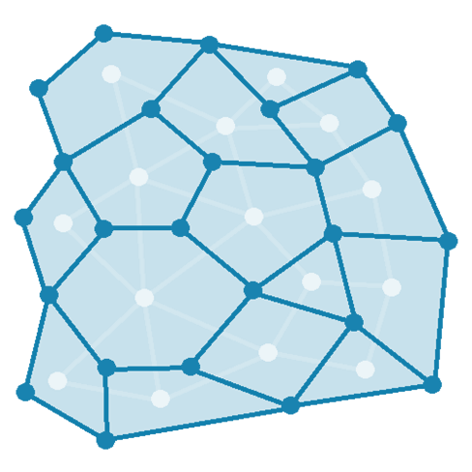
Maze generation algorithm
Graph theory based methods
A maze can be generated by starting with a predetermined arrangement of cells (most commonly a rectangular grid but other arrangements are possible) with wall sites between them. This predetermined arrangement can be considered as a connected graph with the edges representing possible wall sites and the nodes representing cells. The purpose of the maze generation algorithm can then be considered to be making a subgraph in which it is challenging to find a route between two particular nodes.
If the subgraph is not connected, then there are regions of the graph that are wasted because they do not contribute to the search space. If the graph contains loops, then there may be multiple paths between the chosen nodes. Because of this, maze generation is often approached as generating a random spanning tree. Loops, which can confound naive maze solvers, may be introduced by adding random edges to the result during the course of the algorithm. The animation shows the maze generation steps for a graph that is not on a rectangular grid. First, the computer creates a random planar graph G shown in blue, and its dual F shown in yellow. Second, computer traverses F using a chosen algorithm, such as a depth-first search, coloring the path red. During the traversal, whenever a red edge crosses over a blue edge, the blue edge is removed. Finally, when all vertices of F have been visited, F is erased and two edges from G, one for the entrance and one for the exit, are removed.

Slide 9
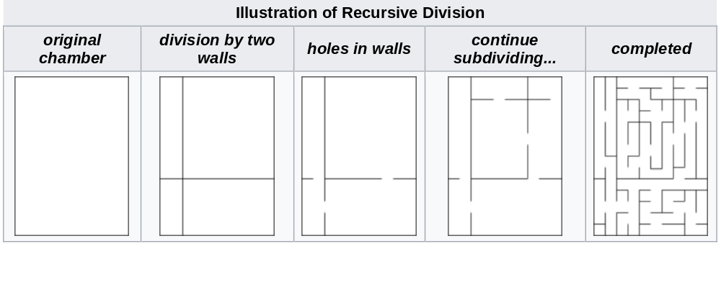
Maze generation algorithm
Recursive division method
Mazes can be created with recursive division, an algorithm which works as follows: Begin with the maze's space with no walls. Call this a chamber. Divide the chamber with a randomly positioned wall (or multiple walls) where each wall contains a randomly positioned passage opening within it. Then recursively repeat the process on the subchambers until all chambers are minimum sized. This method results in mazes with long straight walls crossing their space, making it easier to see which areas to avoid.For example, in a rectangular maze, build at random points two walls that are perpendicular to each other. These two walls divide the large chamber into four smaller chambers separated by four walls. Choose three of the four walls at random, and open a one cell-wide hole at a random point in each of the three. Continue in this manner recursively, until every chamber has a width of one cell in either of the two directions.

Slide 10
Maze generation algorithm
Cellular automaton algorithms
Certain types of cellular automata can be used to generate mazes.[1] Two well-known such cellular automata, Maze and Mazectric, have rulestrings and In the former, this means that cells survive from one generation to the next if they have at least one and at most five neighbours. In the latter, this means that cells survive if they have one to four neighbours. If a cell has exactly three neighbours, it is born. It is similar to Conway's Game of Life in that patterns that do not have a living cell adjacent to 1, 4, or 5 other living cells in any generation will behave identically to it.[1] However, for large patterns, it behaves very differently from Life.[1]For a random starting pattern, these maze-generating cellular automata will evolve into complex mazes with well-defined walls outlining corridors. Mazecetric, which has the rule has a tendency to generate longer and straighter corridors compared with Maze, with the rule .Since these cellular automaton rules are deterministic, each maze generated is uniquely determined by its random starting pattern. This is a significant drawback since the mazes tend to be relatively predictable. Like some of the graph-theory based methods described above, these cellular automata typically generate mazes from a single starting pattern; hence it will usually be relatively easy to find the way to the starting cell, but harder to find the way anywhere else.

Slide 11
Maze solving algorithm
There are a number of different maze solving algorithms, that is, automated methods for the solving of mazes. The random mouse, wall follower, Pledge, and Trémaux's algorithms are designed to be used inside the maze by a traveler with no prior knowledge of the maze, whereas the dead-end filling and shortest path algorithms are designed to be used by a person or computer program that can see the whole maze at once.
Mazes containing no loops are known as "simply connected", or "perfect" mazes, and are equivalent to a tree in graph theory. Thus many maze solving algorithms are closely related to graph theory. Intuitively, if one pulled and stretched out the paths in the maze in the proper way, the result could be made to resemble a tree.

Slide 12
Maze solving algorithm
Random mouse algorithm : This is a trivial method that can be implemented by a very unintelligent robot or perhaps a mouse. It is simply to proceed following the current passage until a junction is reached, and then to make a random decision about the next direction to follow. Although such a method would always eventually find the right solution, this algorithm can be extremely slow.
Wall follower : The wall follower, the best-known rule for traversing mazes, is also known as either the left-hand rule or the right-hand rule. If the maze is simply connected, that is, all its walls are connected together or to the maze's outer boundary, then by keeping one hand in contact with one wall of the maze the solver is guaranteed not to get lost and will reach a different exit if there is one; otherwise, he or she will return to the entrance having traversed every corridor next to that connected section of walls at least once.Another perspective into why wall following works is topological. If the walls are connected, then they may be deformed into a loop or circle.[2] Then wall following reduces to walking around a circle from start to finish. To further this idea, notice that by grouping together connected components of the maze walls, the boundaries between these are precisely the solutions, even if there is more than one solution (see figures on the right).If the maze is not simply connected (i.e. if the start or endpoints are in the center of the structure surrounded by passage loops, or the pathways cross over and under each other and such parts of the solution path are surrounded by passage loops), this method will not reach the goal.Wall-following can be done in 3D or higher-dimensional mazes if its higher-dimensional passages can be projected onto the 2D plane in a deterministic manner. For example, if in a 3D maze "up" passages can be assumed to lead northwest, and "down" passages can be assumed to lead southeast, then standard wall following rules can apply. However, unlike in 2D, this requires that the current orientation be known, to determine which direction is the first on the left or right.

Slide 13
Maze solving algorithm
Dead-end filling
Dead-end filling is an algorithm for solving mazes that fills all dead ends, leaving only the correct ways unfilled. It can be used for solving mazes on paper or with a computer program, but it is not useful to a person inside an unknown maze since this method looks at the entire maze at once. The method is to 1) find all of the dead-ends in the maze, and then 2) "fill in" the path from each dead-end until the first junction is met. Note that some passages won't become parts of dead end passages until other dead ends are removed first.Dead-end filling cannot accidentally "cut off" the start from the finish since each step of the process preserves the topology of the maze. Furthermore, the process won't stop "too soon" since the end result cannot contain any dead-ends. Thus if dead-end filling is done on a perfect maze (maze with no loops), then only the solution will remain. If it is done on a partially braid maze (maze with some loops), then every possible solution will remain but nothing more.
Recursive algorithm
If given an omniscient view of the maze, a simple recursive algorithm can tell one how to get to the end. The algorithm will be given a starting X and Y value. If the X and Y values are not on a wall, the method will call itself with all adjacent X and Y values, making sure that it did not already use those X and Y values before. If the X and Y values are those of the end location, it will save all the previous instances of the method as the correct path.

Slide 14
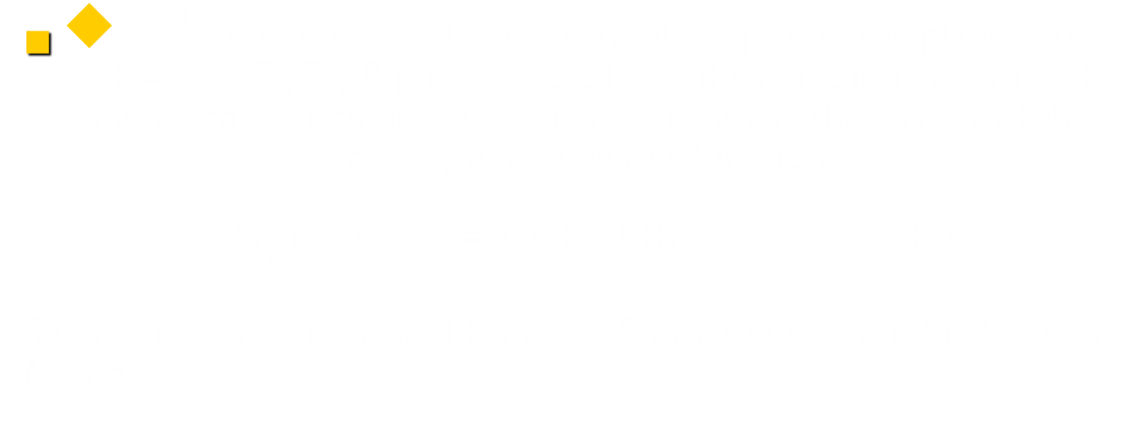
New Method For Maze Solving Algorithms

Slide 15
New Method For Maze Solving Algorithms
Lemma (I) : all the condition that’s possible in the intersections ( choice places )
L B L
L B F
F B L
F B F
R B L

Slide 16
New Method For Maze Solving Algorithms
Lemma (II) : conclusion all the condition that’s possible in the intersections ( choice places )
L B L → F
L B F → R
F B L → R
F B F → B
R B L → B

Slide 17
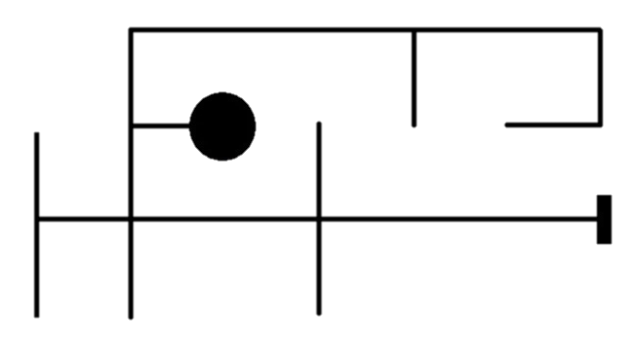
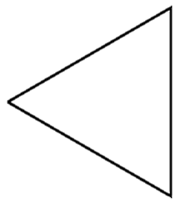
New Method For Maze Solving Algorithms
Example
Start to Solving

Slide 18
New Method For Maze Solving Algorithms
Example
Navigation path

Slide 19
New Method For Maze Solving Algorithms
Example
intersections ( choice places )

Slide 20
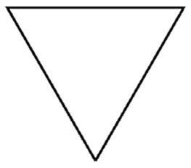
New Method For Maze Solving Algorithms
Example
Answer Space : L

Slide 21
New Method For Maze Solving Algorithms
Example
Answer Space : L

Slide 22
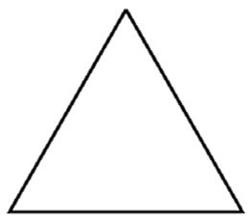
New Method For Maze Solving Algorithms
Example
Answer Space : L B

Slide 23
New Method For Maze Solving Algorithms
Example
Answer Space : L B L

Slide 24
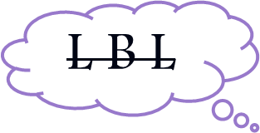
New Method For Maze Solving Algorithms
Example
Answer Space : F

Slide 25
New Method For Maze Solving Algorithms
Example
Answer Space : F L

Slide 26
New Method For Maze Solving Algorithms
Example
Answer Space : F L B

Slide 27

New Method For Maze Solving Algorithms
Example
Answer Space : F F

Slide 28
New Method For Maze Solving Algorithms
Example
Answer Space : F F

Slide 29
New Method For Maze Solving Algorithms
Example
Answer Space : F F L

Slide 30
New Method For Maze Solving Algorithms
Example
Answer Space : F F L B

Slide 31
New Method For Maze Solving Algorithms
Example
Answer Space : F F L B F

Slide 32
New Method For Maze Solving Algorithms
Example
Answer Space : F F R

Slide 33
New Method For Maze Solving Algorithms
Example
Answer Space : F F R B

Slide 34
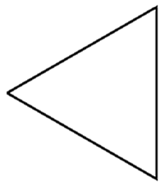
New Method For Maze Solving Algorithms
Example
Answer Space : F F R B L

Slide 35

New Method For Maze Solving Algorithms
Example
Answer Space : F F B

Slide 36
New Method For Maze Solving Algorithms
Example
Answer Space : F F B L

Slide 37

New Method For Maze Solving Algorithms
Example
Answer Space : F R

Slide 38
New Method For Maze Solving Algorithms
Example
Answer Space : F R F

Slide 39
New Method For Maze Solving Algorithms
Example
Answer Space : F R F

Slide 40
New Method For Maze Solving Algorithms
Example
Answer Space : F R F F

Slide 41
New Method For Maze Solving Algorithms
Example
Answer Space : F R F F B

Slide 42
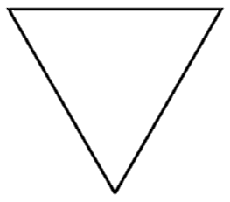
New Method For Maze Solving Algorithms
Example
Answer Space : F R F F B L

Slide 43

New Method For Maze Solving Algorithms
Example
Answer Space : F R F R

Slide 44
New Method For Maze Solving Algorithms
Example
Answer Space : F R F R B

Slide 45
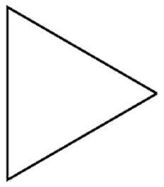
New Method For Maze Solving Algorithms
Example
Answer Space : F R F R B L

Slide 46

New Method For Maze Solving Algorithms
Example
Answer Space : F R F B

Slide 47
New Method For Maze Solving Algorithms
Example
Answer Space : F R F B

Slide 48
New Method For Maze Solving Algorithms
Example
Answer Space : F R F B L

Slide 49

New Method For Maze Solving Algorithms
Example
Answer Space : F R R

Slide 50
New Method For Maze Solving Algorithms
Example
Answer Space : F R R

Slide 51
New Method For Maze Solving Algorithms
Example
Answer Space : F R R
Finish

Slide 52
Applications
Routing
Computer networks
Mines
Coding and decoding
Constructions
Oil pipes
Nano robots for cure

Slide 53
References
[1] Renato Reder Cazangi, Associate,Member, IEEE, and Fernando J. Von
Zuben, Member, IEEE “Immune Learning Classifier Networks: Evolving
Nodes and Connections” , IEEE Congress on Evolutionary Computation
,Canada, 2006
[2] Dimitris C. Dracopoulos;”Robot Path Planning for Maze Navigation”, 1998.
[3] Babak Hosseini Kazerouni, Mona Behnam Moradi and Pooya Hosseini
Kazerouni;”Variable Priorities in Maze-Sloving Algorithms for Robot’s
Movement”, 2003.
[4] Sung-Hee Lee, Junggon Kim, F.C.Park, Munsang Km, and James
E.Bobrow;”Newton-Type Algorithms for Dynamics- Based Robot Movement
Optimization”, Digital Object Identifier, 2004.
[5] Horst-michael gross, Alexander Koenig; “Robust Omniview-basad Probilistic
Self-loalization for Mobile Robots in Large Maze-like Environments”,
proceedings of the 17th International Conference on Pattern Recognition, ICPR-2004.
[6] Shinichiro Yano, Manabu Noda, Hisahiro Itani, Masayuki Natsume, Haruhiko Itoh and
Hajime Hattori, Tadashi Odashima, Kazuo Kaya, Shinya Kataoka and Hideo Yuasa,
Xiangjun Li, Mitsuhiro Ando, Wateru Nogimori and Takahiro Yamada; “A Study of
Maze Searching With Multiple Robots System”, 7th International Symposium on
MicroMachine and Human Science, 1996.

Slide 54
References
[7] Frank Lingelbach; “Path Planning using Probabilistic Cell
Decomposition”, International Conference on Robotics & Automation,
2004.
[8] Javier Antich and Alberto Ortiz; “Extending the potential Fields Approach
to Avoid Trapping Situations”, CICYT-DPI- 2001.
[9] Gorden Mc Comb, Myke Predko,“Robot Builder’s Bonanza”, Mc-Graw
Hill, 2006.
[10] Thomas Braunl; “Embedded Robotics mobile robot design and
applications with Embedded systems”, Springer 2006.
[11]Meng Wang, James N.K. Liu, “Fuzzy Logic Based Robot Path Planning in
unknown Environment, the Fourth International Conference on Machine
Learning and Cybernetics, Guangzhou, 2005
[12] Roland Buchi, Gilles Caprari, Vladimir Vuscovic, Roland Siegwart; “A
Remote Controlled Mobile Mini Robot”, 7th International Symposium on
MicroMachine and Human Science, 1996.

Slide 55
Thanks for your attention!!

Slide 56
FAQ

Slide 57
This Isn't The End ☺

